Slide 1
Node.js File System

Slide 2
Module: fs

Slide 3
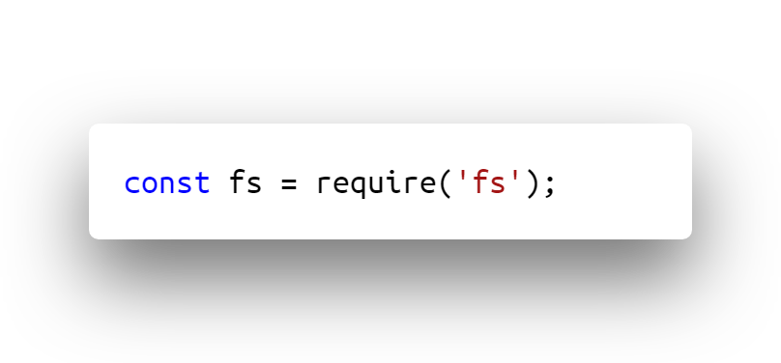
Standard module
Work with the file system on your computer
Read files
Create files
Update files
Delete files
Rename files

Slide 4
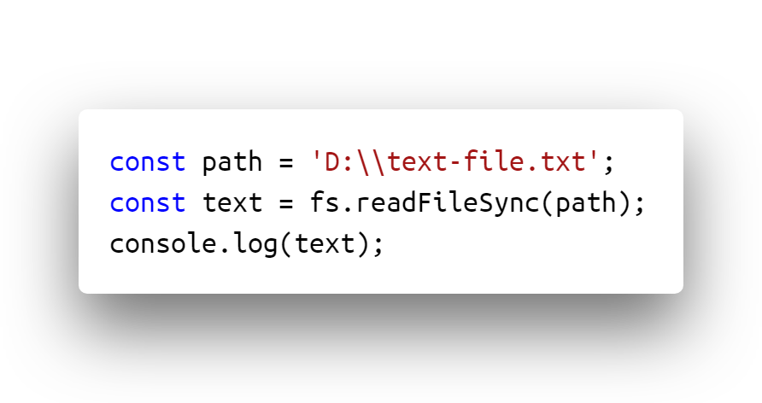
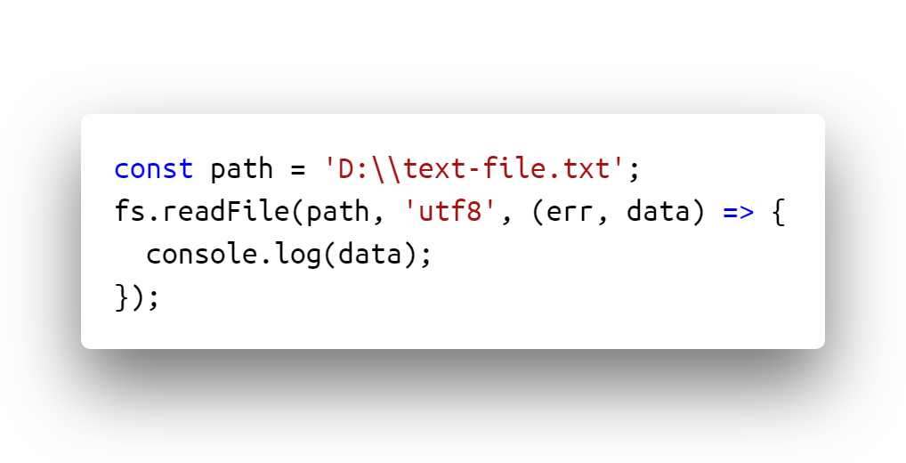
All operations have synchronous & asynchronous forms

Slide 5
Asynchronous form
Last argument is the completion callback
First argument passed to the completion callback is always for an exception
Operation successfully makes first argument null or undefined
Asynchronous operations doesn’t block Node.js
Synchronous form
Block Node.js
Any exception is thrown immediately

Slide 6
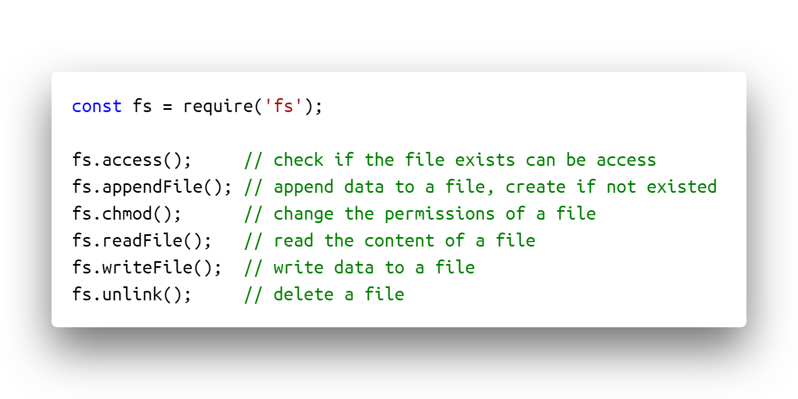

Slide 7
Module: fs-extra

Slide 8

https://github.com/jprichardson/node-fs-extra
https://www.npmjs.com/package/fs-extra
“fs-extra”
Adds file system methods that aren't included in the native fs module and adds promise support to the fs methods.

Slide 9
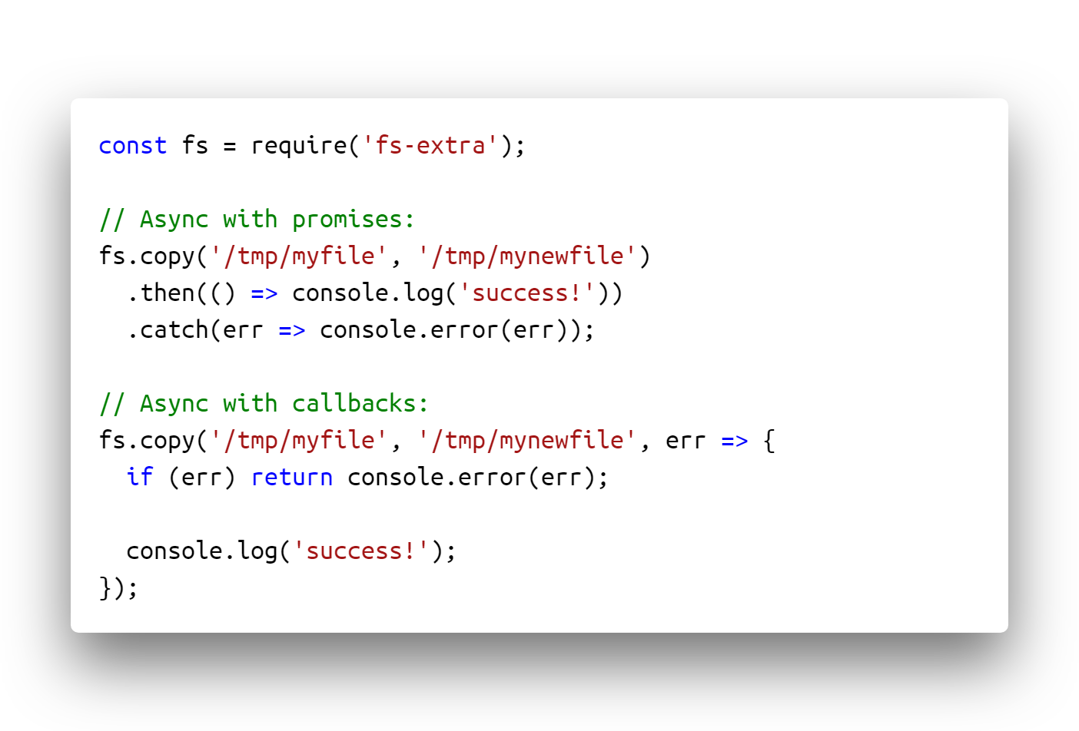

Slide 10
Package | Pros | Cons
fs | Built in module Safe & guaranteed | Inconvenient - fs doesn’t have async methods Must be wrapped in a Promise There is less APIs
fs-extra | Extra APIs as emptyDir, copy, outputJson,... Async methods | An extra bundle Not all APIs works fine (There are some known issues with Sync methods)

Slide 11
Child Process

Slide 12
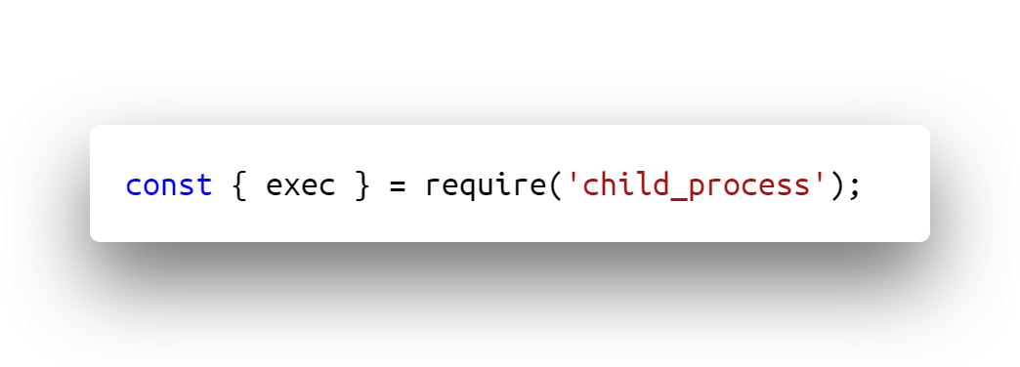
Provides the ability to run child processes
child_process.exec is "synchronously asynchronous":
The exec is asynchronous
Waits for the child process to end and tries to return all the buffered data at once.
If the buffer size of exec is not set big enough, it fails with a "maxBuffer exceeded" error.

Slide 13
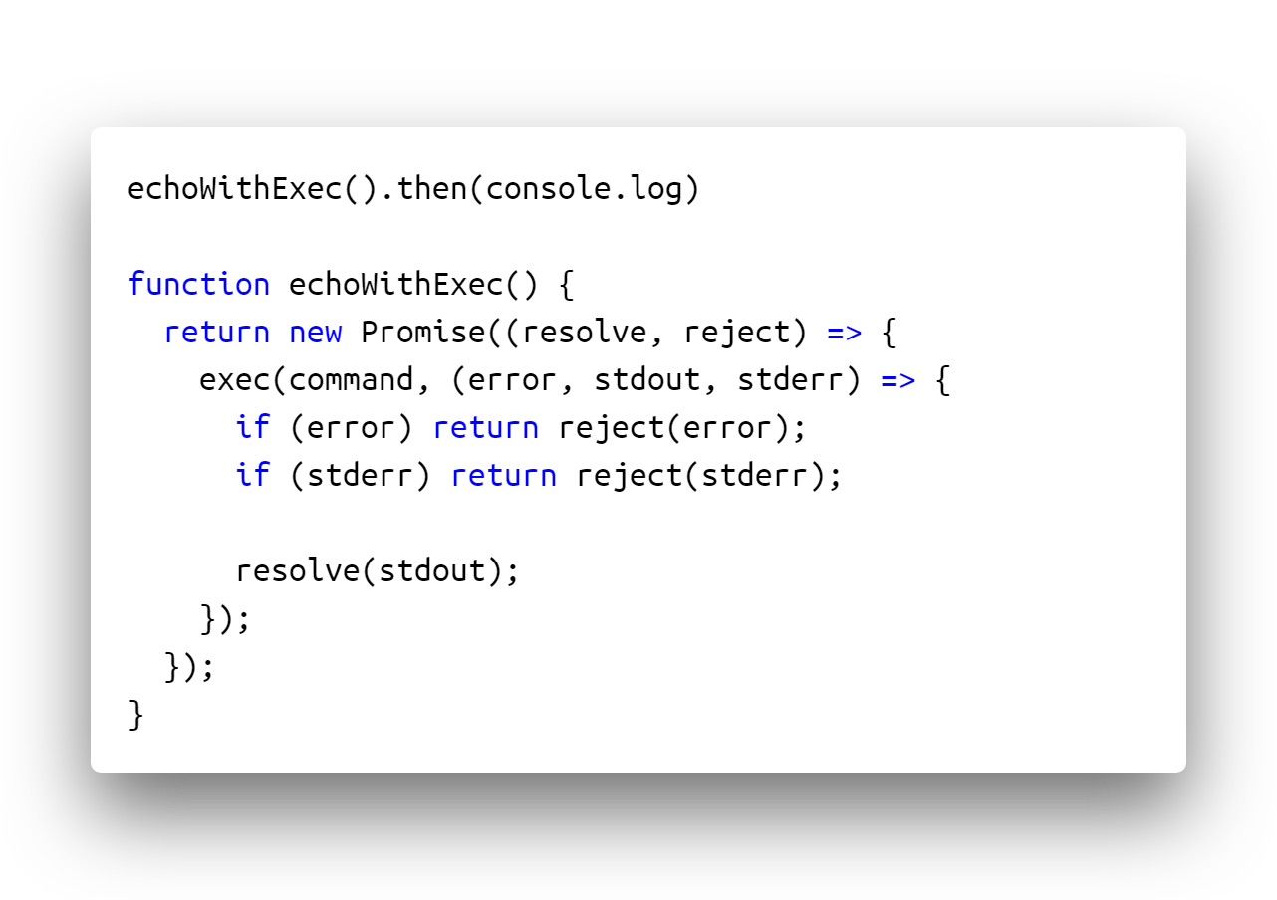

Slide 14
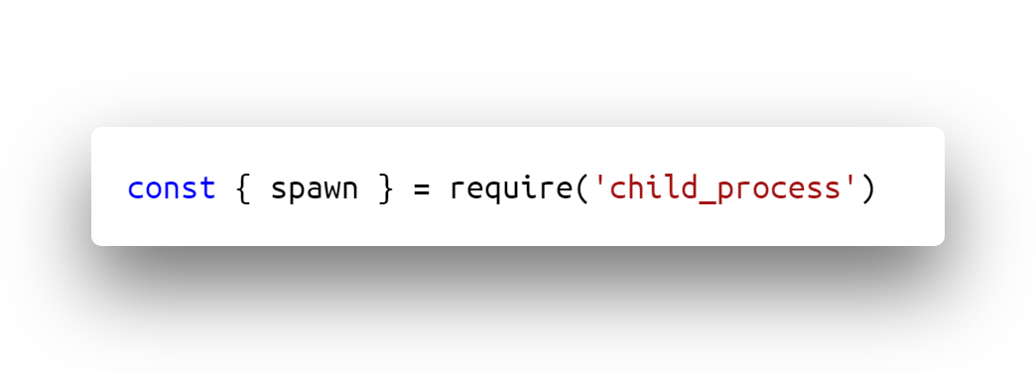
child_process.spawn is ""asynchronously asynchronous":
It starts sending back data from the child process in a stream as soon as the child process starts executing.
You must handle all data & errors by attaching events to the returned ChildProcess object.

Slide 15
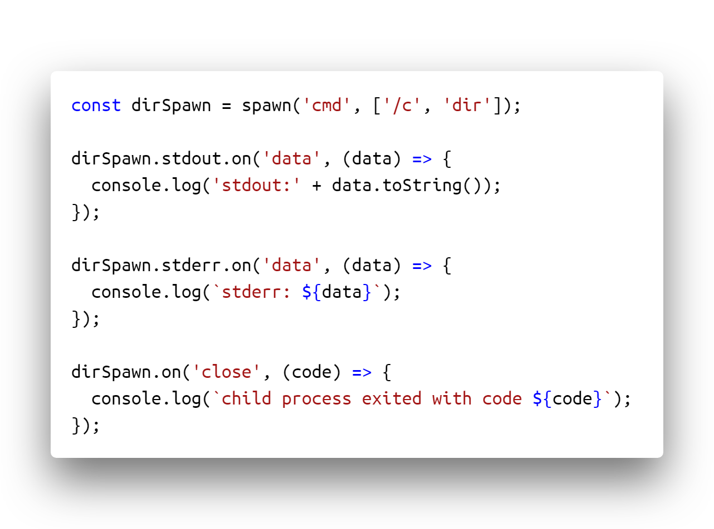

Slide 16
Why child-process?
More functionalities from OS APIs
Workarounds
Why not child-process?
These APIs are different from OS to OS
Break full-stack single-language
Difficulties in creating & managing these APIs
Should we use spawn or exec?
Use spawn if the child process return huge binary data to Node.js
Use exec if the child return light simple messages.

Slide 17
More resources
https://www.w3schools.com/nodejs/nodejs_filesystem.asp
https://flaviocopes.com/node-module-fs/
https://stackabuse.com/writing-to-files-in-node-js/
https://nodejs.org/api/fs.html#fs_file_system
https://nodejs.org/dist/latest-v12.x/docs/api/child_process.html

